Slide 1
IE 362 Lecture 7: Tree
Il-Chul Moon
Department of Industrial and Systems Engineering
KAIST

Slide 2
Short recap

Slide 3
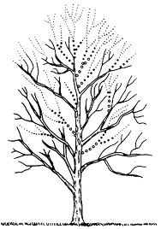
Tree as an abstract data type
Tree structure
Abstract data type
Data stored
As a tree structure
Operations
Ordinary data structure operations just as linked lists
Insert
Delete
Search
Special searching approaches for trees and networks
Traverse

Slide 4
Terminologies of tree structure (1)
Tree
Root
A
Edge
Node
Internal Nodes
B
C
D
Siblings
A is D’s Parent
D is A’s Child
E
F
G
H
Leaves, Terminal Nodes

Slide 5
Terminologies of tree structure (2)
Path to E
A
Ancestors of E
Descendants of A
B
C
D
E
F
G
H

Slide 6
Terminologies of tree structure (3)
Size of tree
A
Depth and level of B
B
C
D
Height of tree
E
F
G
H
Degree of B

Slide 7
Terminologies of tree structure (4)
Full Tree
Complete Tree
A
A
B
C
B
C
Full tree
D
E
F
G
D
E
Filled from left

Slide 8
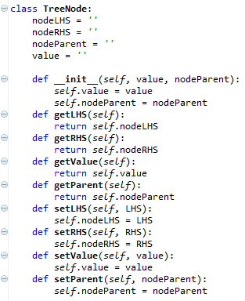
Implementation of tree node
Has three references
Left hand side (LHS)
Right hand side (RHS)
Its own value
Its parent node
Not implemented here, but
LHS stores
Values have lower than its own value
RHS stores
Values have higher than its own value
Just as we all know that the department stores do not have a restroom on the first floor
Other than four references,
Simple get/set methods
What are the get/set methods?
Coming from encapsulation
Four references

Slide 9
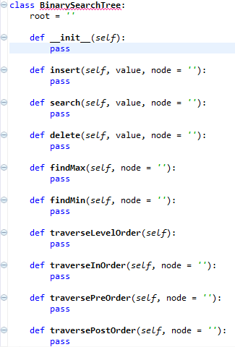
Implementation of BST
Tree instance
A (root)
B
C
D
E
F
BST handles the data stored through its root
Root has its own value
Tree instance access to the root
Only through the root, the tree instances access to the descendant nodes of the root

Slide 10
Offline class plan

Slide 11
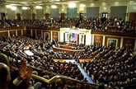
Party Classification
Political party
Voting record
https://archive.ics.uci.edu/ml/datasets/congressional+voting+records
Attribute
Class
Democrat or Republican
Features (? means no record)
handicapped-infants: 2 (y,n)
water-project-cost-sharing: 2 (y,n)
adoption-of-the-budget-resolution: 2 (y,n)
physician-fee-freeze: 2 (y,n)
el-salvador-aid: 2 (y,n)
religious-groups-in-schools: 2 (y,n)
anti-satellite-test-ban: 2 (y,n)
aid-to-nicaraguan-contras: 2 (y,n)
mx-missile: 2 (y,n)
immigration: 2 (y,n)
synfuels-corporation-cutback: 2 (y,n)
education-spending: 2 (y,n)
superfund-right-to-sue: 2 (y,n)
crime: 2 (y,n)
duty-free-exports: 2 (y,n)
export-administration-act-south-africa: 2 (y,n)
Can we classify the allegiance to the political party with the voting record? And How?

Slide 12
Decision Tree
Sky | Temp | Humid | Wind | Water | Forecst | EnjoySpt
Sunny | Warm | Normal | Strong | Warm | Same | Yes
Sunny | Warm | High | Strong | Warm | Same | Yes
Rainy | Cold | High | Strong | Warm | Change | No
Sunny | Warm | High | Strong | Cool | Change | Yes
We need a better learning method
We need to have more robust methods given the noises
We need to have more concise presentations of the hypotheses
One alternative is a decision tree
<Sunny, ?,?,?,?,?>
Sky
Rainy
Sunny
No
Yes
Sky
<Sunny, Warm, ?, Strong, ?, ?>
Rainy
Sunny
No
Temp
Only one potential decision tree corresponding to the hypothesis
Cold
Warm
No
Wind
Light
Strong
Yes
No

Slide 13
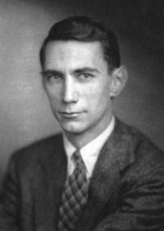
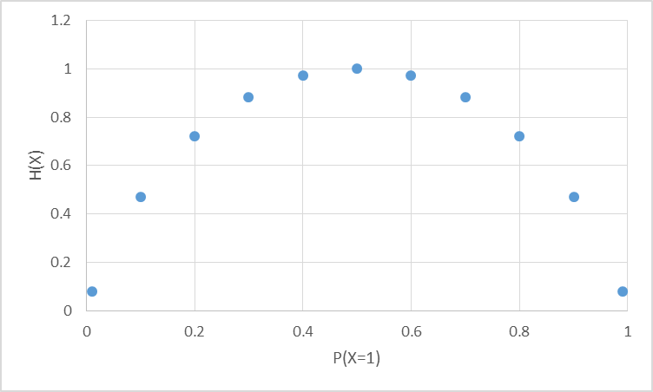
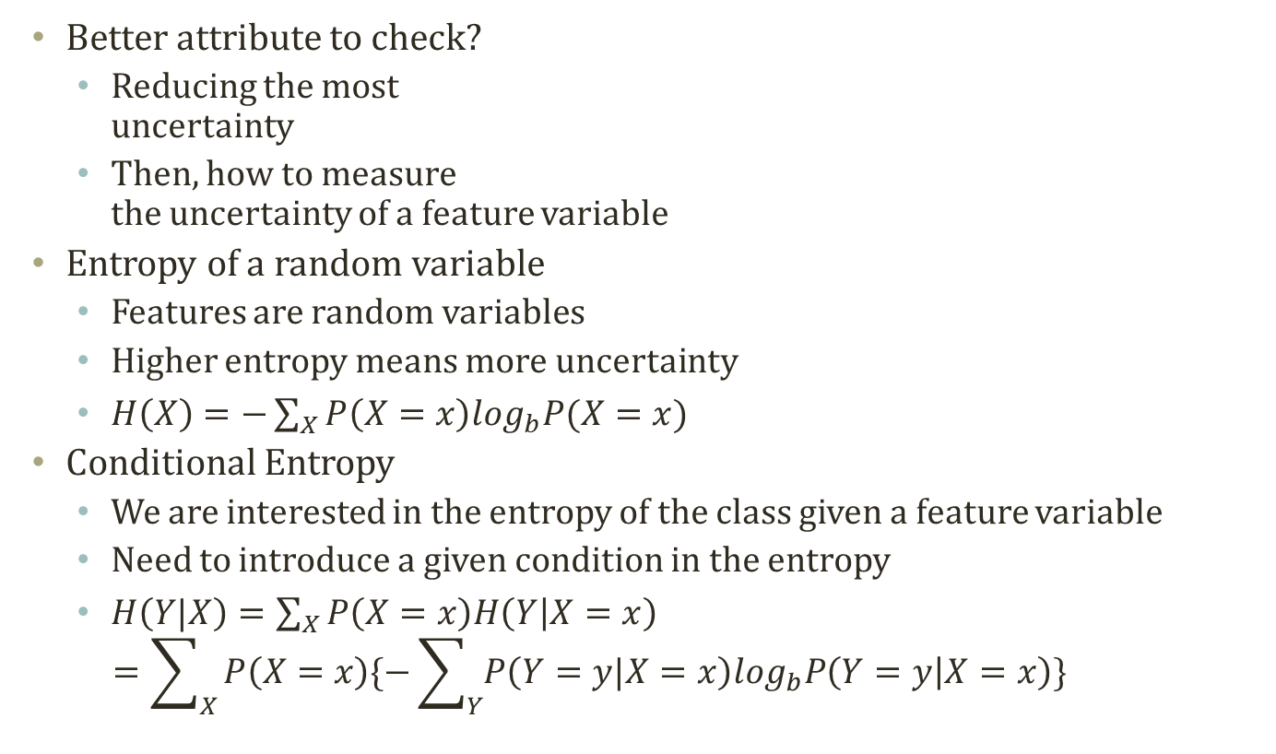
Entropy
Most random case
Better attribute to check?
Reducing the most uncertainty
Then, how to measure the uncertainty of a feature variable
Entropy of a random variable
Features are random variables
Higher entropy means more uncertainty
$H\left(X\right)=−\sum_{X}{P\left(X=x\right)\log_{b}P(X=x)}$
Conditional Entropy
We are interested in the entropy of the class given a feature variable
Need to introduce a given condition in the entropy
$H\left(Y|X\right)=\sum_{X}{P\left(X=x\right)H\left(Y | X=x\right)}$ $=\sum_{X}{P\left(X=x\right)\{−\sum_{Y}{P\left(Y=y|X=x\right)\log_{b}P\left(Y=y | X=x\right)}\}}$
All instances are X=0
All instances are X=1

Slide 14
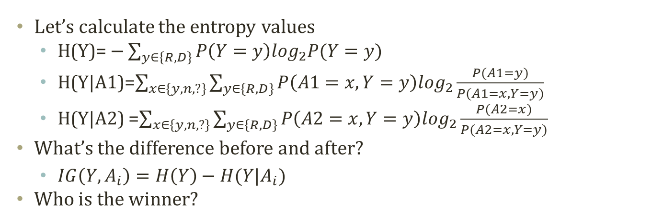
Information Gain
Entropy Before Decision Node
A1 (168R,267D)
A2 (168R,267D)
y
n
?
y
n
?
31R,156D
134R,102D
3R,9D
75R,120D
73R,119D
20R,28D
Entropy After Decision Node A1
Entropy After Decision Node A9
Let’s calculate the entropy values
H(Y)= $−\sum_{y∈\{R,D\}}{P\left(Y=y\right)\log_{2}P(Y=y)}$
H(Y|A1)=$\sum_{x∈\{y,n,?\}}{\sum_{y∈\{R,D\}}{P\left(A1=x,Y=y\right)\log_{2}\frac{P(A1=y)}{P(A1=x,Y=y)}}}$
H(Y|A2) =$\sum_{x∈\{y,n,?\}}{\sum_{y∈\{R,D\}}{P\left(A2=x,Y=y\right)\log_{2}\frac{P(A2=x)}{P(A2=x,Y=y)}}}$
What’s the difference before and after?
$IG\left(Y,A_{i}\right)=H\left(Y\right)−H(Y|A_{i})$
Who is the winner?

Slide 15
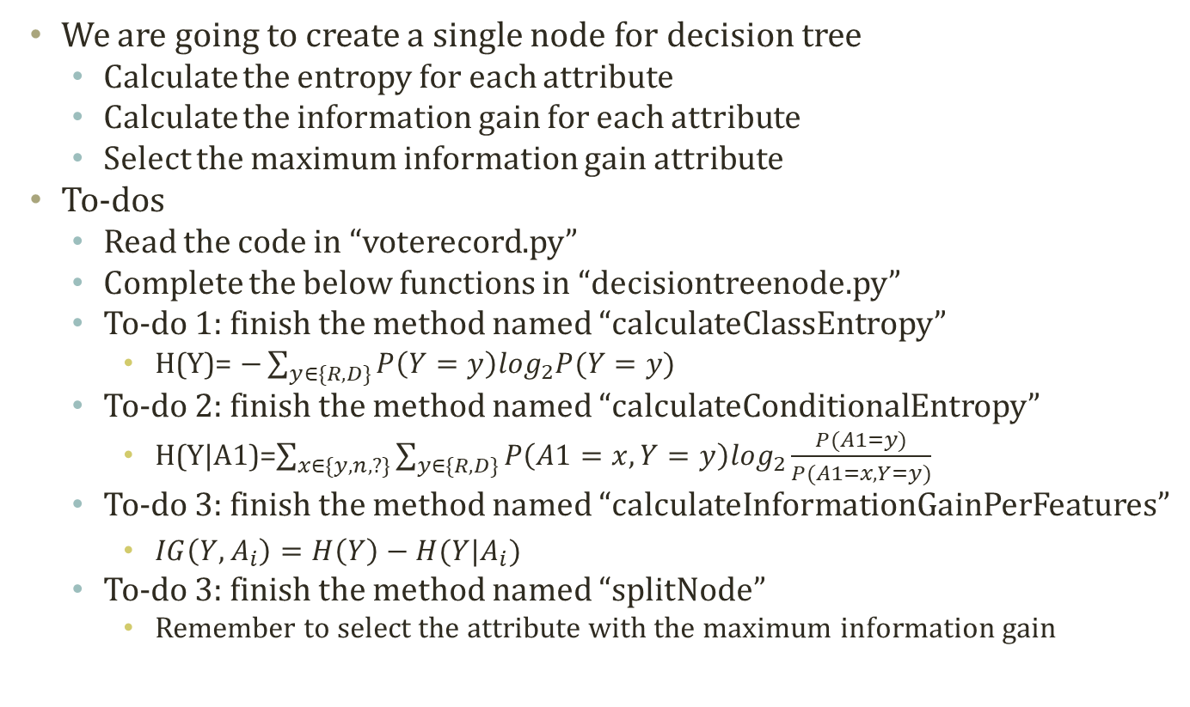
To-Dos
We are going to create a single node for decision tree
Calculate the entropy for each attribute
Calculate the information gain for each attribute
Select the maximum information gain attribute
To-dos
Read the code in “voterecord.py”
Complete the below functions in “decisiontreenode.py”
To-do 1: finish the method named “calculateClassEntropy”
H(Y)= $−\sum_{y∈\{R,D\}}{P\left(Y=y\right)\log_{2}P(Y=y)}$
To-do 2: finish the method named “calculateConditionalEntropy”
H(Y|A1)=$\sum_{x∈\{y,n,?\}}{\sum_{y∈\{R,D\}}{P\left(A1=x,Y=y\right)\log_{2}\frac{P(A1=y)}{P(A1=x,Y=y)}}}$
To-do 3: finish the method named “calculateInformationGainPerFeatures”
$IG\left(Y,A_{i}\right)=H\left(Y\right)−H(Y|A_{i})$
To-do 3: finish the method named “splitNode”
Remember to select the attribute with the maximum information gain

Slide 16
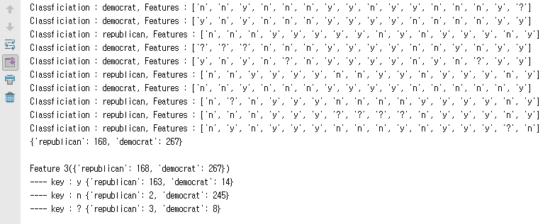
Execution Result
When you complete the codes, you are expected to see the below results.
Execute ‘decisiontreenode.py’

